Slide 1
Cover Crop Management
Notes:
Cover crops are a practice to consider when you are looking to implement a SHMS and help meet the SH principles

Slide 2

Objectives
1. List benefits of cover crops
2. Identify the different plant functional groups
  Name 2-3 representative species in each group that are common to most of the US.
  List key benefits of the representative species
3. Determine how to manage cover crops
Notes:
Planting/termination methods, the importance of recognizing life history traits, such as phenology/reproductive strategies, growth patterns, moisture requirements and how that’s management is key to understanding how and where cover crops fit within rotation and how to make sure we are mitigating the risks that may be associated with adding a cover crop into a production agriculture system where they might not have been before.
Picture: oats, cow peas, field peas, sunflowers

Slide 3
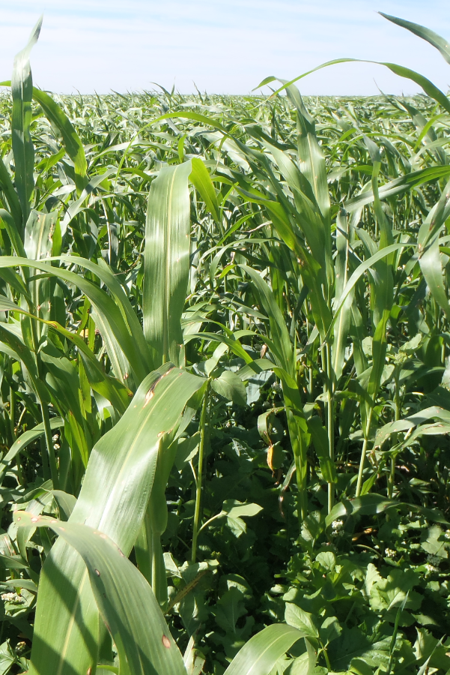
Cover Crop Purposes
Identify Resource
Concerns & Objectives
Crop diversity (habitat)
Soil surface armor (erosion)
Build stable soil aggregates
Improve water cycle/ availability
IPM/beneficial insects
Build or improve soil organic matter
Nutrient cycling/ efficiency/ acquisition
Air Quality
Adjust carbon/nitrogen ratios
Wildlife winter food & shelter
Livestock integration
N fixation
Remsberg, SARE
Notes:
You may change photo to local representation
Before listing the bulleted points on why we might convince a producer to include cover crops as part of their rotation, have the group chime in on why they might suggest incorporating cover crops into an operation? See how many of these points they can get! if you want to you can chart them and hang on the classroom wall.
Improve water cycle/availability HUGE purpose in dryland systems. Improve water infiltration, maybe trap and retain snow
C:N-high ratio: can rotate between high and low C:N species within rotation (brassica in corn stalk residue)
Livestock integration: sometimes the only way it is economically feasible to incorporate cc into a dryland system is to get that added revenue stream of integrating livestock into the system.
Photo courtesy of Dan Palic up in NE CO: turnip, forage radish, sorghum sudangrass, oats mix

Slide 4
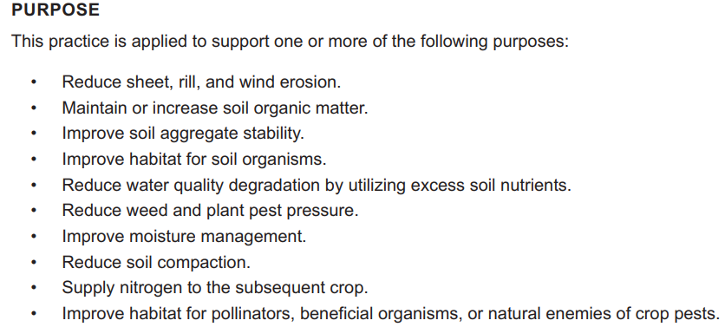

Cover Crop CPS (340)
Notes:
Insert 340 cover crop standard for the area that training is taking place. Soil health should be considered on all land uses. Each state has adopted / modified the national standard and Job sheets to use in conservation planning. This module will not go into detail for this standard. This course does not supersede state specific guidance.
Make note that a lot of these purposes align with our previous slide and that many of them are outright goals of our producers.
Conservation planners should always review the state specific 340 cover crop standard and all supporting materials. Planners should also be aware of potential negative effects of certain cover crop species on specific cropping systems within your own state or area. For example, be cautious of planting cereal rye or annual ryegrass in wheat dominant cropping system.

Slide 5
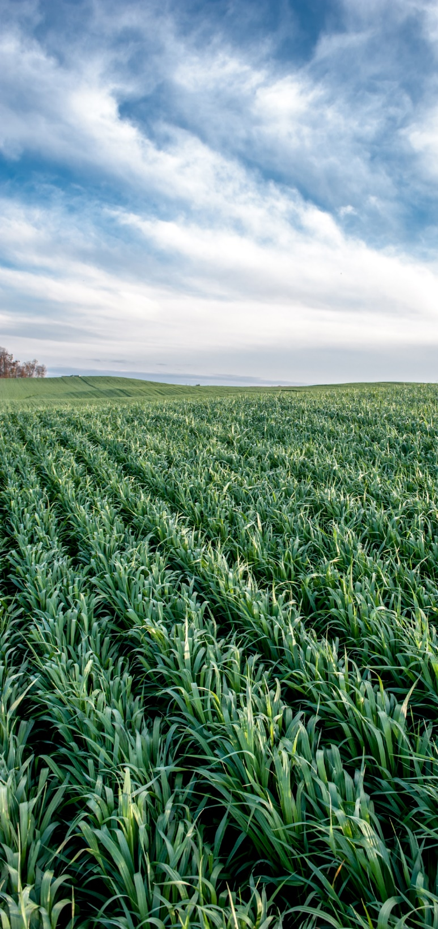
Cover Crop Considerations
for Successful Planning
Site preparation
Early weed control
Timing and species (adequate growing season)
Crop rotation/diversity
Seed quality (bin run, PLS, certified)
Seeding method seed-soil contact (broadcast vs. drilling)
Seed size/seeding depth
Legume inoculation
Moisture management (cover benefits, water use)
Producer’s goals
Remsberg, SARE
Notes:
You may change photo to local representation
Spend a little more time explaining as needed, as these are not explained in more detail later in the presentation:
Site preparation: same for all conservation seedings, need good seed to soil contact, ask questions like how much residue will you be planting into, what equipment does the producer have for seeding/terminating? Drill vs broadcast, will you be planting into a growing crop? How much moisture is available for my mix? Are the weeds adequately controlled? will there be any herbicide carryover that could affect cover crop?
Early weed control: get the cc in as early as possible to eliminate weed pressure
Crop rotation/diversity: consider incorporating all the plant functional groups into your rotation where possible. Understand that the more diverse the mix is, the harder it can be to manage. Consider combinations of cover crop mixes to achieve more objectives, however it is more cost effective to limit mixtures to species that will reliably achieve objectives than to try too many species at once. Can be a common misconception, sometimes a really well-developed mix that has 3 species is much more successful (and economically feasible) then a mix that has 17 different species

Slide 6
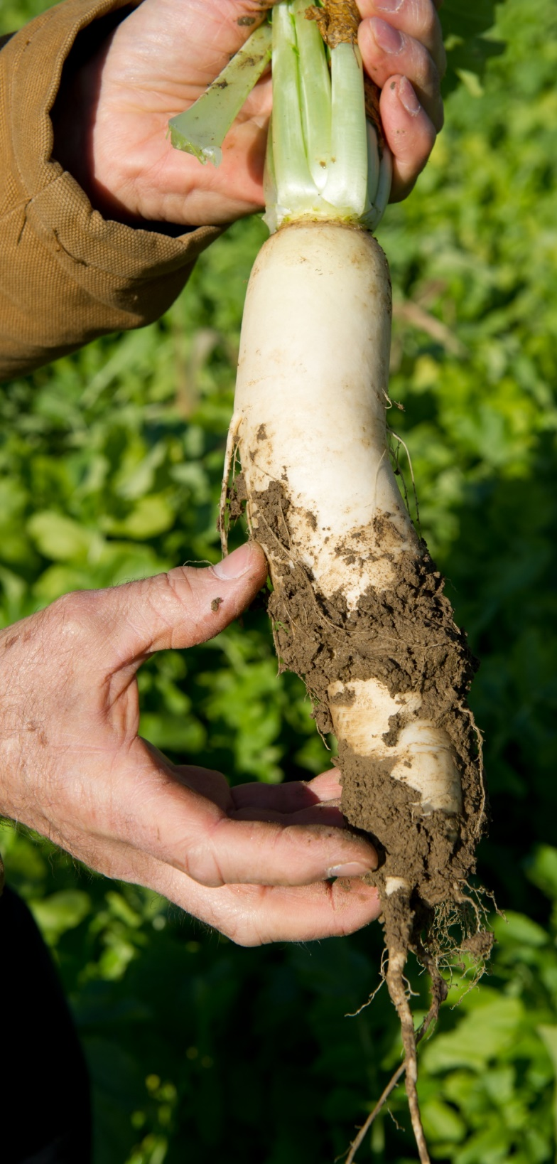
Cover Crop Considerations
for Successful Planning
Residue management (cash crop) before & after cover crop emergence
Nutrient cycling (C:N ratio, residual NO₃)
Weed, insect & disease management
Termination method/timing
    Know how you are going to terminate before you plant
Economics
    Yield impacts (+/-), cost of establishment, soil improvement, can we afford not to use them?
Remsberg, SARE
Notes:
Residue management – Does the residue from the previous cash crop need to be conditioned in some way to facilitate the cover crop establishment ( crimper roller, mower, straw harvest in high yield environments leaving appropriate residue amounts to support soil health principles) Consider maintaining residues to leaving standing to facilitate better planting conditions, mowing sizes residue, windrows, orients residue horizontal, perpendicular to planting equipment making hair pinning more common.
Nutrient Cycling – Look at current cropping system and assess its C:N ratio. Is it heavy carbon or heavy nitrogen? Use cover crop species to balance the C:N ratio to avoid immobilization, nutrient tie up and possible nutrient losses through leaching.
Insect and disease management – know your current pest and predators in your cropping system and scout to monitor economic thresholds for treatment. Consider management styles sterility vs competitive disease management.
Economics – with all of the environmental issues occurring nationwide, (nitrates, water quality, soil erosion, air quality) can we afford not to use a cover crop in current cropping systems?

Slide 7

What is your Seeding Timeframe ?
Spring - Fallow ground, prevented planting or prior to a summer crop
Early Summer - After early vegetable harvest, winter grain or small grain forage harvest, after first crop hay
Late Summer - After grain harvest, Interseeding into corn or soybean, cotton etc.
Fall - After fall crop harvest
Remsberg, SARE
Notes:
**Add local examples of seeding windows. When can the producer plant CC in his rotation? The easiest in most rotations is behind small grain crops.
Be aware of crop insurance implications, they seem to be a constant moving target
There may be short windows to grow cover crops ex. 60 days between cash crops to build diversity, scavenge nutrients, and suppress weeds.
These are the four major opportunities to seed cover crops in traditional cropping systems.

Slide 8
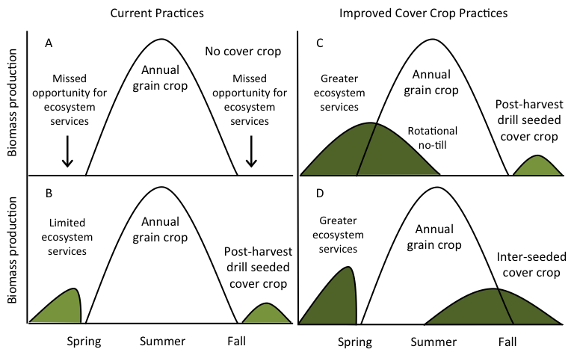
Cover Crops Niches for Summer Annual Crops
Planting green
Inter-seeding
and
Planting green
Matt Ryan, Cornell University
Notes:
**Discuss other planting windows for your region. You can add additional slides to showcase these windows. Before activating animation, you can ask the participants if they see opportunities to increase ecosystem services to the fullest extent possible.
Objectives:
Overcomes primary obstacle limiting adoption of cover crops
Reduces soil erosion from intensive storms in late summer and early fall
Increases potential for different species and greater services
Conservation planners may encounter producers whose operation may be at different levels of providing ecosystems services. The graphics in A, B, C, and D highlight these possible levels in regard to the producer's current management. Relate and discuss these graphics with common cropping systems in your area to assist in illustrating how managing cover crops can be strengthened to provide for more ecosystem services.
Graphic A – This illustrates many cropping systems that do not include cover crops. Notice areas before and after the annual grain crop where living roots are absent and ecosystem services are not provided to the system.
Graphic B – This illustrates a cropping system where a producer is utilizing cover crops. Cover crops are planted at the conclusion of harvest activities and terminated before the annual grain crop is planted. Notice gaps in biomass production before and after annual grain crop and cover crops. These times are absent of living roots and still offer missing ecosystem services. This graphic likely represents a majority of producers that have started or have been implementing cover crops. Planners do have the opportunity to identify this and possibly promote further cover crop management to move towards increasing ecosystem services that are identified in graphics C and D.
Graphic C – This illustrates an increased management that includes cover crops being planted after annual grain crop harvest. Cover crops are allowed to grow longer in the spring achieving additional amounts of biomass. Annual grain crop planting and cover crop termination are completed very close together and are part of planting green scenario. Allowing cover crops to grow right up to cash crop planting narrows the gap considerably where living roots would have been absent from the system. Note: Presenters – review applicable cover crop termination guidelines and RMA guidance for your area for possible planning implications.
Graphic D – This graphic illustrates a cropping system where the management is focused to provide ecosystem services as much of the year as possible. Slide animation is present: The graphic first shows including an inter-seeding event late during the cropping season. This allows cover crops to be seeded and established while the annual grain crop is drying down prior to harvest. As light increases through the crop canopy, cover crops germinate and become established. Harvest activities allow full sunlight and cover crops are able to continue to grow with a head start. Inter-seeding interest has grown over the years where cropping seasons are short or producers are pushing the envelope to having living roots in the system as much as possible. By clicking again to show animation, a shaded area is included that would represent planting green to compliment the system.

Slide 9
Seeding Considerations
Earlier seeding results in better seed germination, tillering, growth, survival and more biomass.
Delaying termination in spring can compensate for delayed planting in the fall (some producers have learned to plant green)
Be aware of planting dates based on species in the mix (warm / cool season; winter grains /cool season legumes and brassicas)
Drilling is much more efficient than surface broadcast. Increase seeding rate by 10-30% when broadcasting (some states have specific, higher rates for broadcast vs. drilling).
Higher seeding rates are not necessarily good – can be detrimental (i.e., increases competition for limited resources)
Notes:
Many of these can make or break a producer from success. Making them aware of these considerations highly depends on their operation and time and comfort level.
Earlier seeding results in better seed germination, tillering, growth, survival and more biomass.
Late fall planted cover crop seeds have less (much less) germination due to decreasing soil temps than early fall seeded cover crops. Biomass can be exponentially less. Some late planted seed can over winter and germinate the next year.
Delaying termination in spring can compensate for delayed planting in the fall (some producers have learned to plant green)
In most cases allowing termination to be delayed for several weeks into the break of spring will allow substantial biomass to be produced above and below ground.
Be aware of planting dates based on species in the mix (warm / cool season; winter grains /cool season legumes and brassicas)
For instance, make sure to identify warm season species that are in mixes that you plan to seed and that appropriate time is available for growing prior to killing frost. For example in northern latitudes it may not be practical to plant a warm season species in the month of September due to likelihood of killing frost.
Drilling is much more efficient than surface broadcast. Increase seeding rate by 10-30% when broadcasting.
Reliability for surface (aerial, highboy, non-disturbance) broadcasting rates without incorporation is dependent on residue cover (ie seeding prior to leaf defoliation), rainfall, or soil moisture or ability to irrigate than seeding rate alone

Slide 10
**Discuss other planting windows for your region. You can add additional slides to showcase these windows. Pictures of field plantings. To show the windows of opportunities

Slide 11
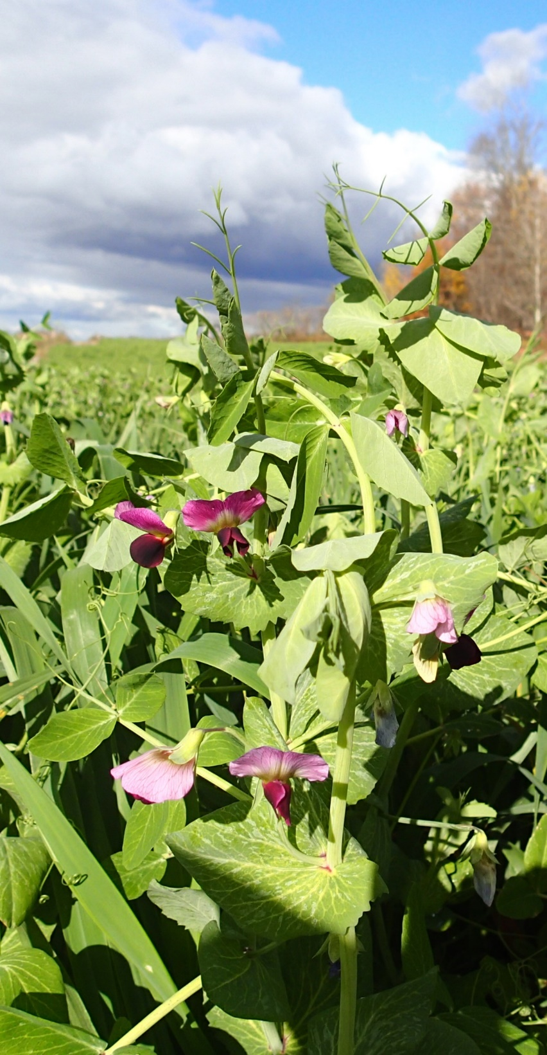
What Characteristics Should Be Considered?
Growth cycle
Growth habit
Root architecture
Growth rate
Chemical composition
Stress tolerance
Time to flowering
Pest resistance or susceptibility
Nutrient dynamics
Pytlik, NRCS
Notes:
Growth Cycle- Perennial, Biennial, Annual?
Above ground- (erect, viney, spreading, single/multi-stemmed, height, leaf character)
Root architecture- (tap, fibrous, rhizomatous, depth)
Rate of growth- (also differs by growth stage i.e. seedling vigor)
Chemical composition- (allelopathy C:N ratio, root exudates) oats accumulate more N than triticale/ millets have no prussic acid compared to sorghum sudangrass.
Tolerance to stress- (drainage, pH, shade, low fertility)
Time to flowering- (termination or self seeding issue) caution Mustard and buckwheat species flower very quickly within 60 days.
Pest resistance or susceptibility
Nutrient Dynamics: will it sequester nutrients? How much when will release occur? what impact on following crop or will it provide nutrients? Legumes, brassicas that winter kill and release quickly

Slide 12
What to Seed
Choosing the right cover crop for:
  Nutrient availability
  Nutrient requirements
  Stabilizing nutrients
  Weed suppression
  Insect and disease suppression
  Erosion Control
  Forage: not a purpose of a cover crop but valuable
  Acceptable planting and termination techniques for the producer
  There may be other objectives identified during the planting process to address

Slide 13
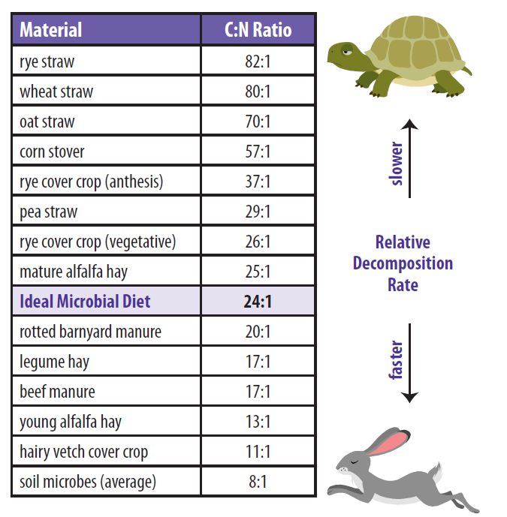
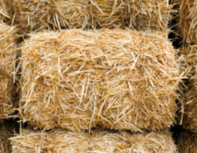
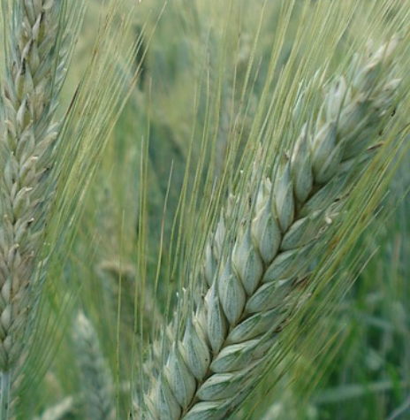
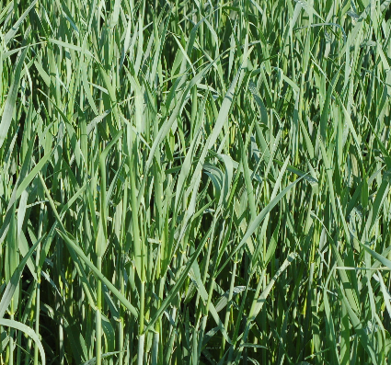
C:N ratio in Cover Crops
(Nutrients Availability & Decomposition Rate)
Best for Legumes
Best for Corn or Cereals
Notes:
Understanding plant species growth stage and relationship to Carbon:Nitrogen is key to overall strategies SEE HANDOUT C:N RATIO NRCS
Review chart and discuss various situations. Notice that Rye has varying C:N ration depending on when it is terminated.
Low C:N ration plants breakdown quickly, discuss the advantages and disadvantages of this,

Slide 14

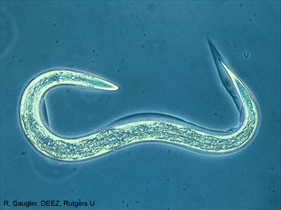
Nitrogen Mineralization
Bacteria
Bacteria Feeding Nematode
C:N ratio about 5:1
C:N ratio about 10:1
5:1
10:1
Notes:
This is only a small part of the process but I think it gives you a basic idea of how life, death and mineralization works in that Rhizosphere.
Everything is made up of differing amounts of carbon and nitrogen. C/N ratios vary between specie but generally Bacteria have a lower C/N ratio than a Nematode.
Bacteria are around 5:1 and a Nematode, which eats the bacteria, is 10:1. A Nematode will need to eat two Bacteria to get 10 units of Carbon but it only needs one of the Nitrogen units, so he excretes the extra into the soil in a form that a plant can very readily take up. That is exactly what we want to happen as long as there is a plant there to take up that Nitrogen.

Slide 15
Nitrogen Mineralization
Bacteria
Bacteria Feeding Nematode
C:N ratio about 5:1
C:N ratio about 10:1
Consume two bacteria to get enough carbon for function and reproduction
Notes:
This is only a small part of the process but I think it gives you a basic idea of how life, death and mineralization works in that Rhizosphere.
Everything is made up of differing amounts of carbon and nitrogen. C/N ratios vary between specie but generally Bacteria have a lower C/N ratio than a Nematode.
Bacteria are around 5:1 and a Nematode, which eats the bacteria, is 10:1. A Nematode will need to eat two Bacteria to get 10 units of Carbon but it only needs one of the Nitrogen units, so he excretes the extra into the soil in a form that a plant can very readily take up. That is exactly what we want to happen as long as there is a plant there to take up that Nitrogen.

Slide 16
Nitrogen Mineralization
Bacteria
Bacteria Feeding Nematode
C:N ratio about 5:1
C:N ratio about 10:1
Consume two bacteria to get enough carbon for function and reproduction
Only
Needs
1 part N
Notes:
This is only a small part of the process but I think it gives you a basic idea of how life, death and mineralization works in that Rhizosphere.
Everything is made up of differing amounts of carbon and nitrogen. C/N ratios vary between specie but generally Bacteria have a lower C/N ratio than a Nematode.
Bacteria are around 5:1 and a Nematode, which eats the bacteria, is 10:1. A Nematode will need to eat two Bacteria to get 10 units of Carbon but it only needs one of the Nitrogen units, so he excretes the extra into the soil in a form that a plant can very readily take up. That is exactly what we want to happen as long as there is a plant there to take up that Nitrogen.

Slide 17
Nitrogen Mineralization
Bacteria
Bacteria Feeding Nematode
C:N ratio about 5:1
C:N ratio about 10:1
Consume two bacteria to get enough carbon for function and reproduction
Only
Needs
1 part N
Excrete 1 part N to soil solution as Plant Available N
Notes:
This is only a small part of the process but I think it gives you a basic idea of how life, death and mineralization works in that Rhizosphere.
Everything is made up of differing amounts of carbon and nitrogen. C/N ratios vary between specie but generally Bacteria have a lower C/N ratio than a Nematode.
Bacteria are around 5:1 and a Nematode, which eats the bacteria, is 10:1. A Nematode will need to eat two Bacteria to get 10 units of Carbon but it only needs one of the Nitrogen units, so he excretes the extra into the soil in a form that a plant can very readily take up.
Plant available N, exactly what we want… right???
If this biological Mineralization process occurs in the soil under this green and growing plant it will likely be picked right up by the plant.
Where does it go if there is not a plant growing at that time???

Slide 18
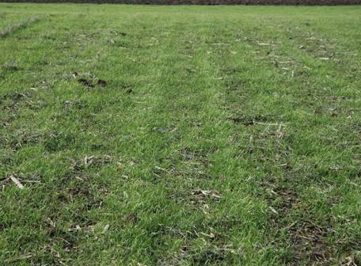
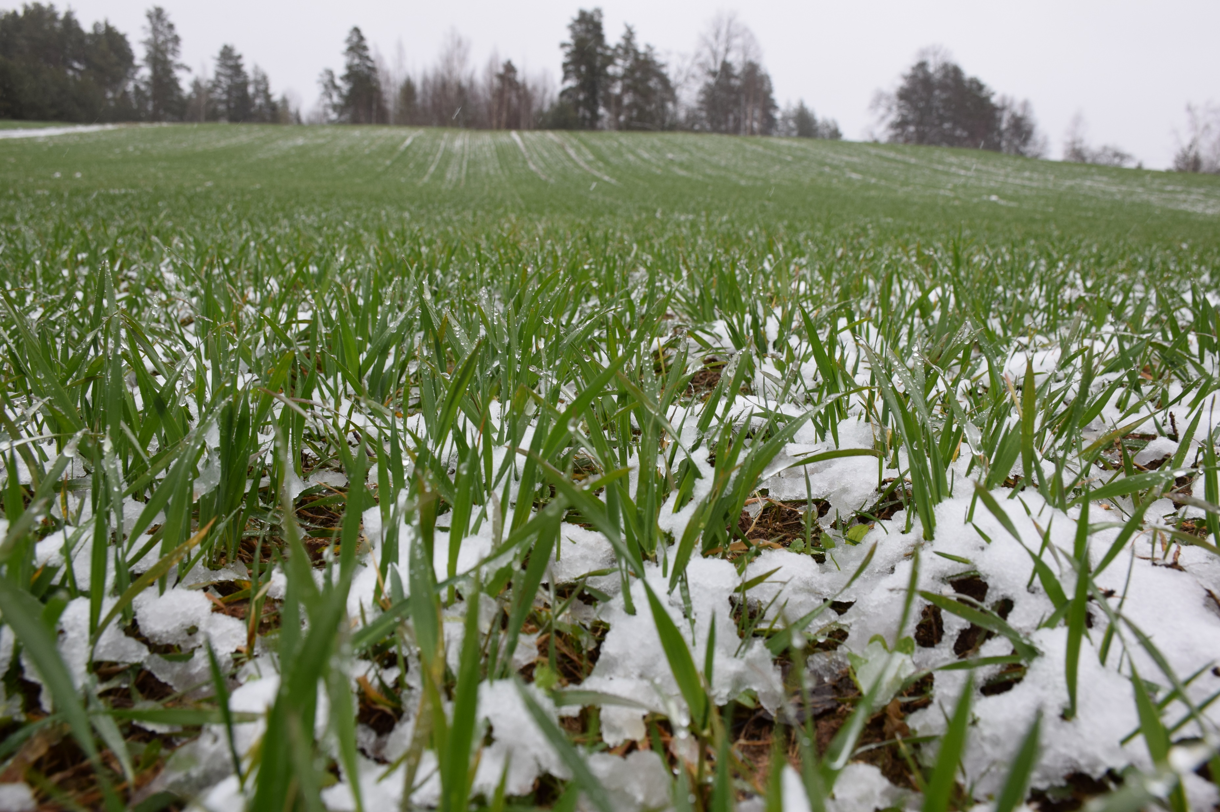
Reduce N Losses
Nitrate mineralized from crop residues and soil OM Is highly soluble through the winter.
Nitrogen leaching can be significant even without fall N applications.
Notes:
This slide leads to the next

Slide 19
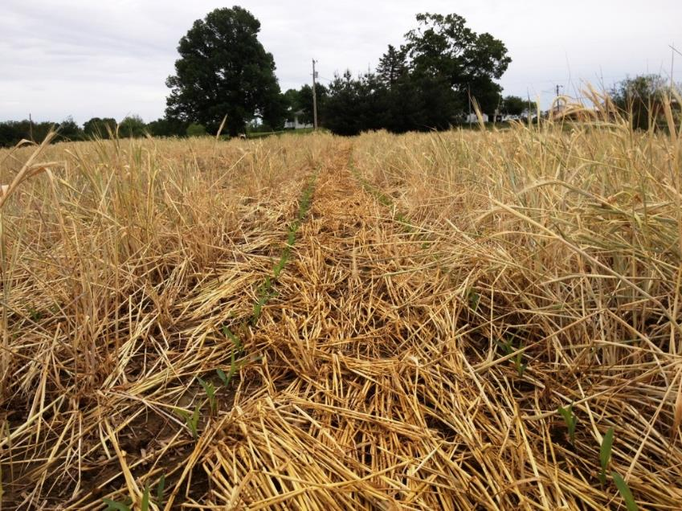
Residue Management for N Retention and Weed Control
NRCS | SHD | Ecological Management | v2.3
Notes:
But what if you are planting a cereal? Do you want all your N tied up?

Slide 20

Nitrogen Immobilization
Cover Crop
Bacteria
C:N ratio about 40:1
C:N ratio about 5:1
Notes:
This is only a small part of the process but I think it gives you a basic idea of how life, death and mineralization works in that Rhizosphere.

Slide 21
Nitrogen Immobilization
Cover Crop
Bacteria
C:N ratio about 40:1
C:N ratio about 5:1
Consume enough carbon from the rye for respiration & body structure
Notes:
In this scenario the microbe take his five carbons and his one nitrogen but there is a lot of carbon left over. So if we exponentially multiply this out over billions of microbes they will get their carbon but the N is gone so they start working on the Nitrogen in the soil and your cereal that comes up in this residue will be starved for N. Therefore you need to either feed additional N or you need to plant a lower C:N ratio cover or a combination of the two. In the case of Organic when you turn the green under you have a quick food source available for microbes and this process is sped up. You have excited the microbes by adding O2 in the soil and gave them a food source so you need something that will feed that system N asap. I.E. composted manure fish emulsion etc.

Slide 22
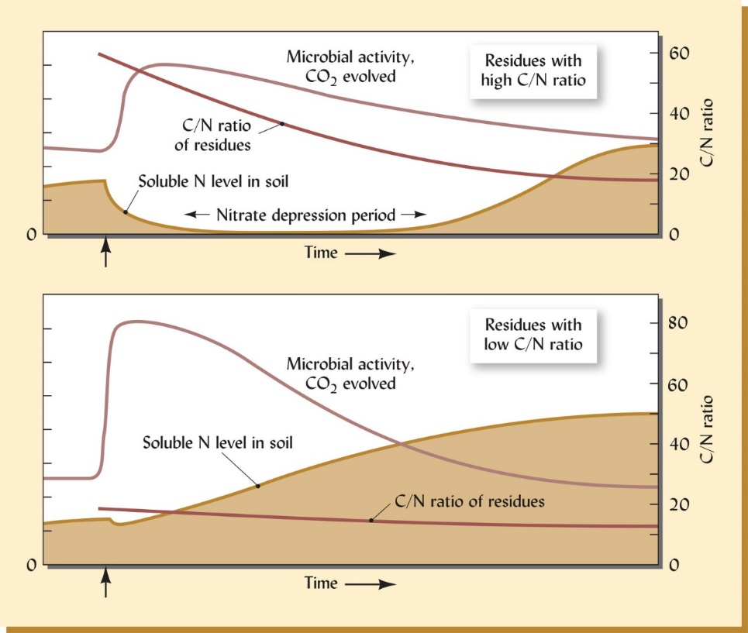
How C:N is Impacted by Microbes
Weil and Brady, The Nature and Properties of Soils, 15e
Notes:
From Nature and properties of soils caption: Changes in microbial activity in soluble nitrogen level and residual c/n ratio following the addition of either high (upper figure, think corn stover or mature small grains) or low (lower figure, think legumes or other forbs) c/n ratio organic materials,. Where the c/n ratio of added residue is above 25, microbes digesting the residues must supplement the nitrogen contained in the residues with soluble nitrogen from the soil. During the resulting nitrate depression period, competition between higher plants and microbes would be sever enough to cause nitrogen deficiency in the plants. Note that in both case soluble N in the soil ultimately increase from its original level once the decomposition process has run its course. The trends shown are for soils with out growing plants, which if present, would continually remove a portion of the soluble nitrogen as soon as it is released.
What this shows is when you plant cereal rye in the upper part you end up with a time period of low soil nitrogen due to microbial scavenging to break down the residue. After the plant starts to break down further there is a realase of organic nitrogen back to the soil which will feed the crop from a timing standpoint for CR it is abour 12-14 weeks. Think of the lifecycle of a crop plant that is usually in corn and beans when they are flowering and N demand is even higher.
When you have a legume cover is planted you end up with a larger soil pool of N. This is why it is important to think of planting cereals or corn after a legume so they can use the organic nitrogen provided.

Slide 23
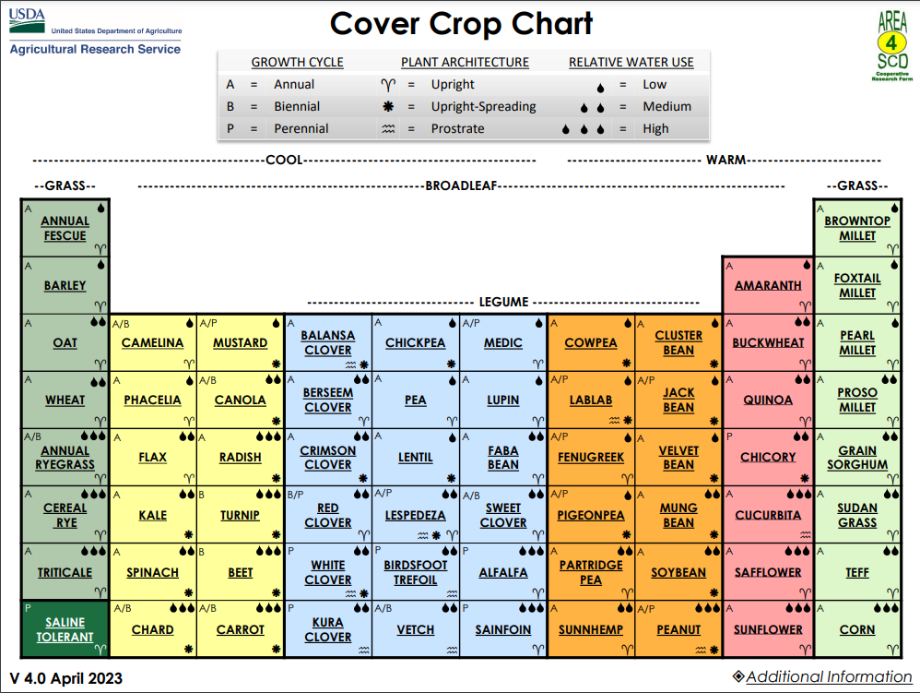
USDA –ARS Cover Crop Chart
Cover Crop Chart
USDA-ARS NGPRL
Notes:
CHOOSE OAT FOR NEXT SLIDE as and example.
Show cover crop periodic table, at USDA –ARS website, You can download the chart onto your lap top and review document on the screen
Are all these species practical for cover crop use in your area? (carrot, peanut, beet, chard, spinach) are seed commercially available?
It is likely that all these species listed in the chart are actual commodity crops somewhere in the world.
Presenters could substitute or add additional cover crop planning resources

Slide 24
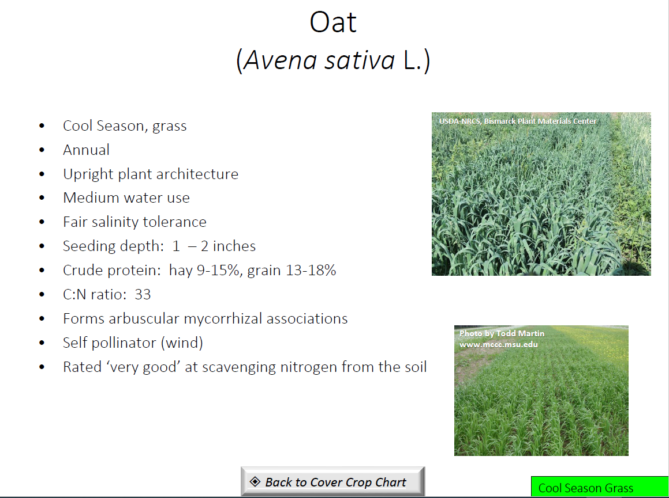
This is an example of using the ARS Cover Crop Chart
Notes:
This is an example of using the ARS Cover Crop Chart: Click on Oats it brings you to this slide that has a brief outline some other helpful characteristics that could help you understand how it may or may not achieve your client’s objectives and address any identified RCs.

Slide 25
Functional Groups
Warm Season
Grasses, Broadleaves and Legumes
Cool Season
Grasses, Broadleaves and Legumes
Notes:
Some say there are only 4 functional groups, we broke them out into 6 to point out the cover crops that have potential to produce nitrogen i.e. legumes.

Slide 26
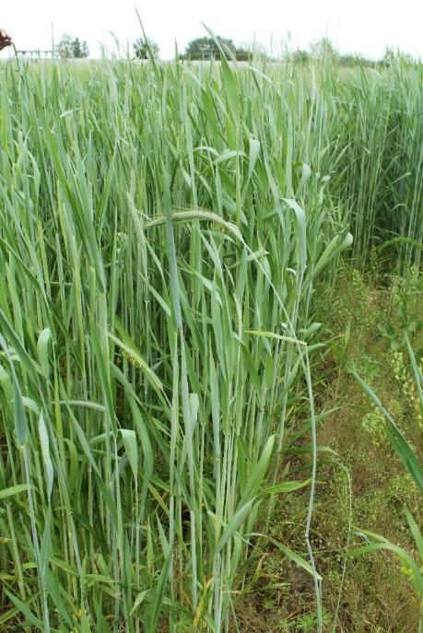
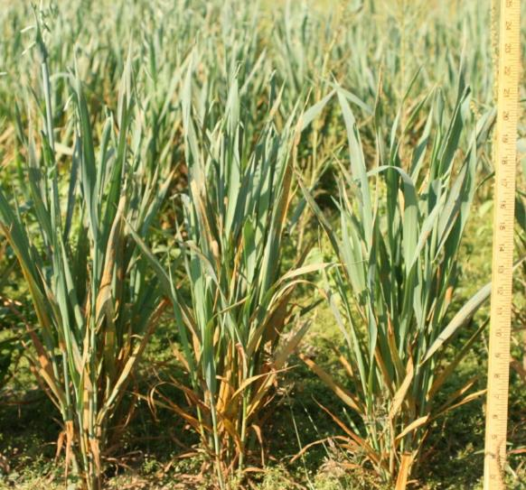
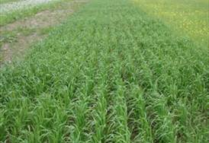
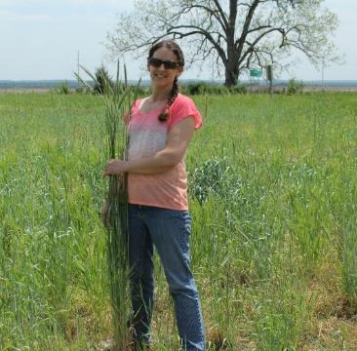
Cool Season Grasses
Annual Ryegrass
Cereal Rye
Barley
Oats
Wheat
Triticale
Cereal Rye
Cereal Rye
Spring Oats
Oats
&
cowpeas
Photos: Michael Kucera & Jodie Reisner
Notes:
Discuss planting windows niches and potential advantages or management actions.
Annual Ryegrass Annual Rye Grass has several desirable traits which include: Ability to germinate in very cold temperatures and grow root mass during most of the winter months even when below the freezing level. Studies have shown that the root exudes have chemical compounds that will help weaken fragipans allowing its roots to penetrate. This leaves root channels that subsequent plant roots can make use of. It also has good forgeability and can produce several pounds of dry matter. The seed is light so it is well suited for drone applications and does well being broadcast.There are some cautions to be aware of as well: Annual Rye Grass can be difficult to terminate if not done correctly and timely. When broadcasting it can drift out of the area of intention. It can also reseed itself if allowed to mature. It can also contaminate cash crops such as wheat or other small seed crops and be difficult to clean out.
Cereal Rye: A cool season upright winter annual that is considered the gateway cover crop, many plant this as their first cover in the fall. Has a tendency to use moderate to high amounts of water, has many different varities that have very different growth heights in different areas of the US. IT is considered a great nitrogen scavenger, hence it may cause issues planted before corn, and makes associations with AMF. Good tolerance to saline soils. Good rooting depth
Barley: A cool season upright winter annual or spring annual depending upon variety. In some places winter barley may not overwinter. A very low water using crop or cover crop, has good tolerance for saline soils. Can scavenge N from soil. Makes association with AMF. Has very long awns so look for awnless varieties for grazing.
Oats: A cool season spring planted cereal. Has good nitrogen scavenging ability, High mycorrhizal association. Medium water use. Fair tolerance to saline soils.
Wheat: There are spring varieties and winter. Older varieties of wheat are more beneficial from a biomass standpoint then new varieties or traited varieties they have significantly less biomass. Rooting depth is low to moderate depends on variety. Medium water user, has very good ability to scavenge nitrogen. Benefits from making a AMF association. For some it is a good alternative to cereal rye due to availability issues and inability to plant due to state constraints, see cautions slide. Fair salinity tolerance
Triticale: Cross between wheat and cereal rye, so it is a good choice in seed wheat country as it is not seen as an issue of being an intolerable weed if left to go to seed. IT is a high water using cover crop. Has Good tolerance to saline soils and makes associations with AMF. Usually awnless so decent for grazing.

Slide 27
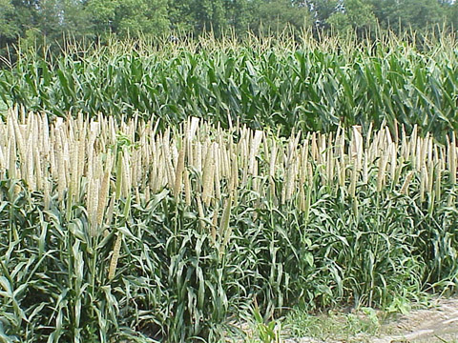
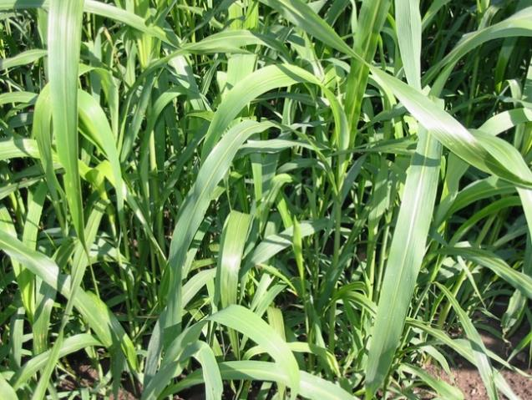
Warm Season Grasses
Pearl Millet
Japanese Millet
Sorghum-Sudan grass
Forage Sorghum
Teff
Pearl Millet
Brown rib sorghum - sudan grass
Photos: Michael Kucera & Jodie Reisner
Notes:
Discuss planting windows niches and potential advantages or management actions. I did not include seeding rates since they vary by state for all species.
Brown mid rib types are favorites of pearl millet, forage sorghum and SXS for those that implement grazing into the farm system. Better digestibility. Also dwarf types which may be good in mixes with cool season species.
Pearl millet: is a tall summer annual bunchgrass. Pearl millet is well adapted to sandy and/or infertile soils. Although requires residual N for biomass growth. Long lasting residue the following spring after winterkilling.
Sorghum-sudangrass: is a cross between forage or grain sorghum and sudangrass. It is a warm-season annual grass that grows well in hot, dry conditions and produces a large amount of biomass. Often reaching 6 feet in height, it can be mowed to enhance biomass production. If not mowed stems can be a challenge to plant into. Scavenger of N but also requires some residual N to put on biomass. Roots good to remediate compaction. Long lasting residue the following spring after winterkilling. Research on nematode suppression by sorghum-sudangrass is not conclusive. does well when planted in mixtures, providing effective support for viney legumes like velvetbean and indeterminate cowpea.
Forage Sorghum
best if seeded after soil temperatures exceed 65 degrees. Maturity can be expected in 60 to 70 days. It is a single growth crop. Forage Sorghum can produce high levels of prussic acid so grazing should occur before frost or after the entire plant has been terminated by frost.
Japanese Millet (Enchinochloa frumentacea) - Japanese millet is an annual grass that grows 2 to 4 feet tall. It resembles, and may have originated from barnyardgrass. The inflorescence is a brown to purple panicle made up of 5 to 15 sessile erect branches. Japanese millet is commonly grown as a late-season green forage. If weather conditions are favorable, it grows rapidly and will mature seed in as little as 45 days. It performs poorly on sandy soils. Performed well even from mid-August planting
German (foxtail) millet (Setaria italica) - German or foxtail millet is an annual warm season grass that matures quickly in the hot summer months. Although German millet has a fairly low water requirement, it doesn't recover easily after a drought because of its shallow root system. Grain formation requires 75 to 90 days. German millet forms slender, erect, and leafy stems that can vary in height from 2 to 5 feet. A small seeded crop, German millet requires a relatively fine, firm seedbed for adequate germination.

Slide 28
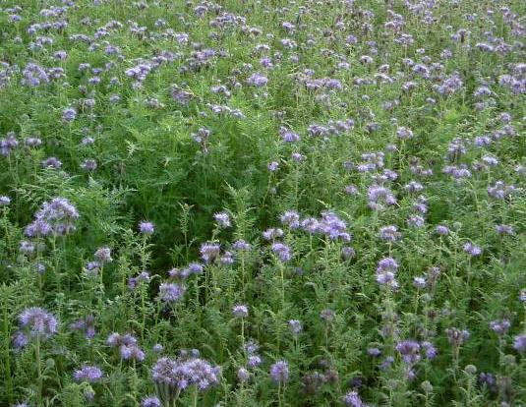
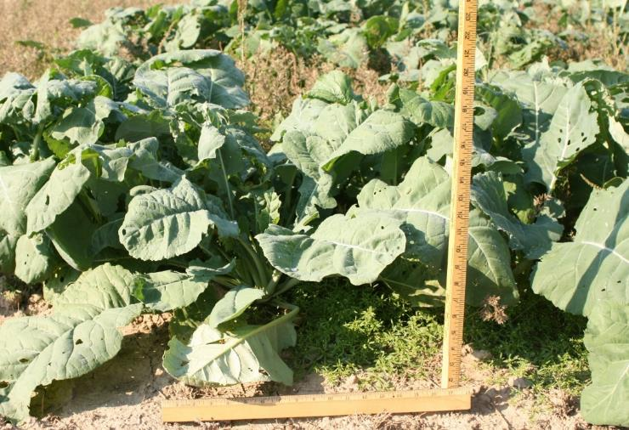
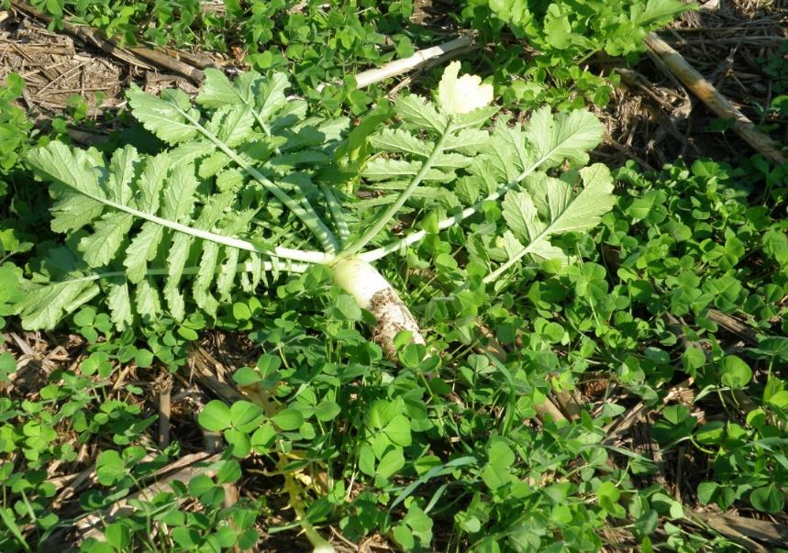
Cool Season Broadleaves
Phacelia
Radish
Turnip and Rape
Kale and Collards
Mustard
Phacelia
Radish
Impact Forage Collard
Photos: Michael Kucera & Jodie Reisner
Notes:
Discuss planting windows niches and potential advantages or management precautions.
Oil seed Radish
Phacelia: Rapid Growth – Taproot, Pollinators & Beneficial insects, Winter killed (PHZ 5b)
Brassicas: watch for insect and disease issues when other brassicas are in rotation. Will provide fall ground cover in 30 days. Need adequate residual soil nitrogen. All provide good winter annual weed control. They do not tolerate poorly drained soils. Need to plant next crop early in spring before nutrients leach.
Radish: tillage or daikon have thick tap root but longer thinner tap root noted for compaction remediation. Also excellent in weed control. Do not use more than 2 lb/ac in a mix with legumes. 4 to 5 lb/ac as monoculture. If planted too early will bolt. Radishes reported to have some nematode control. Oil seed radish provides multiple branches and tends not to heave out of soil like the daikon types.
Mustards: Brown mustard variety “Caliente 199 blend” Bio fumigation needs warm temperatures flail mowing and incorporation and cultipacking 2 weeks prior to planting. yellow mustard stem residue can remain erect throughout the winter months, aid in capturing snow to help build moisture in the soil profile. Do not plant too early to avoid going to seed. Brown mustards slower to bolt in summer than yellow.
Turnips: Depending on region turnips will winterkill slower than radish so will hold onto some of their nutrients longer in the spring. Some varieties bred for top growth for forage. Makes a strong rosette and bolts later than rapeseed. Rosette provides good soil cover for minimal winter growth. Can survive until after snow melts, thereby releasing nitrogen that will be available to the following crop.
Rape: Rape typically has some winter survival depending on the year, will generally do as well as winter canola especially var. Dwarf Essex. Varieties vary in there winter hardiness. Generally rape is non GMO
Winter Canola: Belonging to the same species as rape, canola is a specific cultivar of the rape plant that is grown to produce food grade oil. Be cautious that most canola has GMO traits and tolerant to common burndown herbicides containing Glyphosate.
Kale and collards: Vernalization is required for collards and Kale to bolt (become reproductive) therefore planting anytime during the growing season will result in pure vegetative growth. Collards like the other mustards provide high quality feed value and can be used for grazing.
Phacelia: is native to Southwestern United States, attracts pollinators and beneficial insects, phacelia winter kills at approximately 18ºF , drought tolerant and grows well given 7 to 18 inches of annual precipitation,
It features a very intense soil conditioning effect in the top two inches of soil.. Phacelia is a long day plant, flowering only when days are longer than 13 hours.

Slide 29
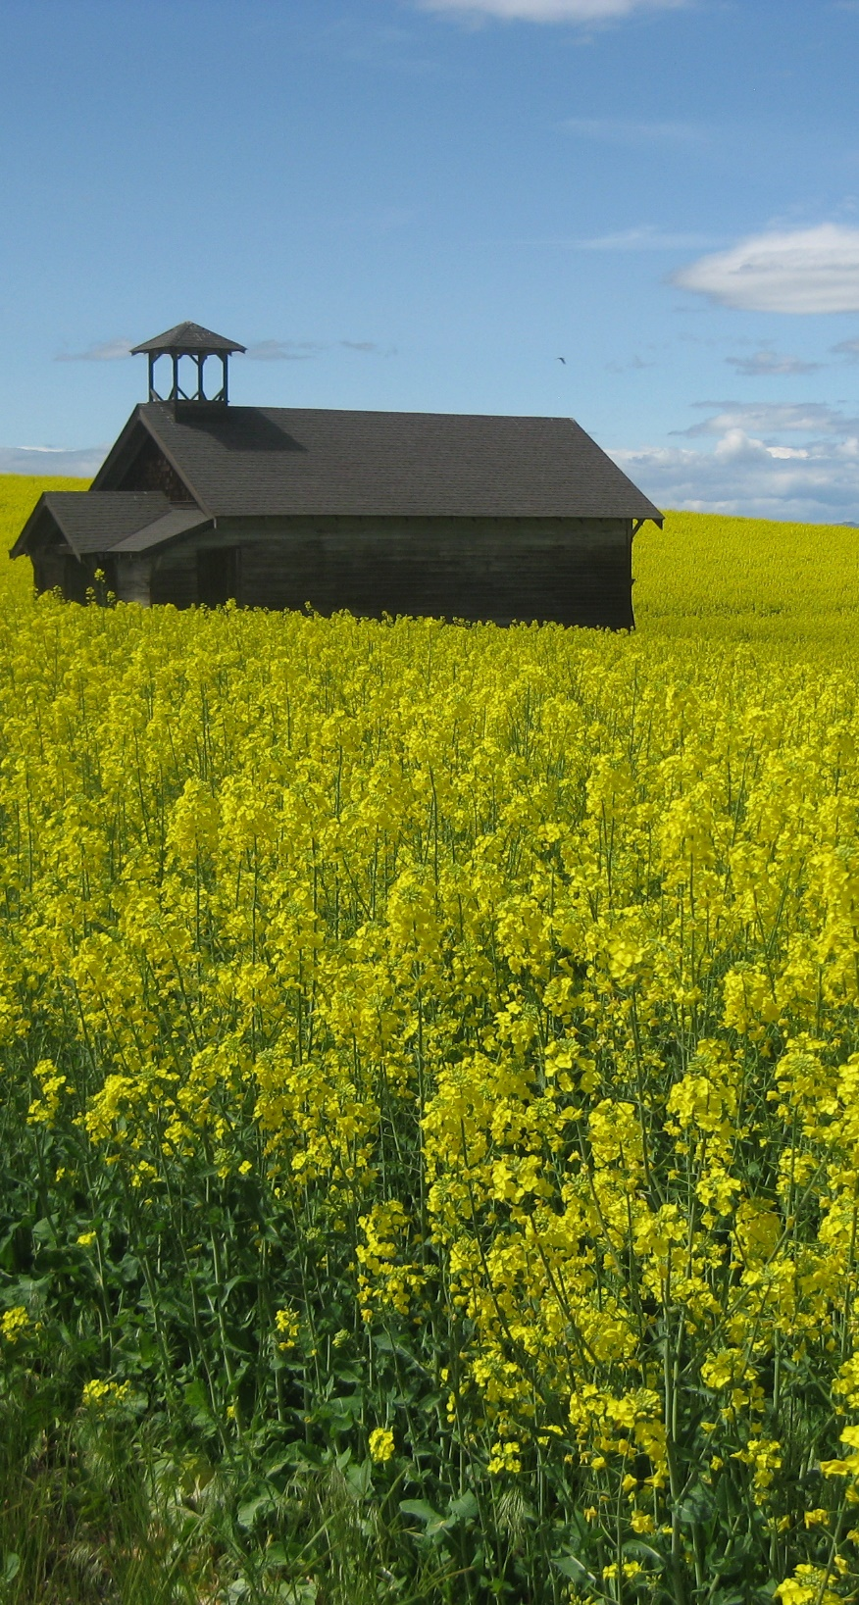
Know How & When Cover Crops Produce Seed so They Don’t Become a Problem
Radishes are photoperiod sensitive Longer days = seed set
  Avoid spring/early summer
Mustards mature quickly, blooming in 45-60 days after planting
Some brassicas (turnips, collards) require vernalization (needs chilling) to make viable seed
Climate dependent, some brassicas can over winter
Duyck, NRCS
Notes:
Can change picture to local representation
CCs that go to seed could become a weed problem. However, these cover crops are considered a commodity crop somewhere and generally not considered weedy in nature. Management considerations to terminate these quick seeding species is key to avoiding potential weed issues.
When radishes are planted in spring or summer before fall equinox they will bolt and go to seed. When planted after fall equinox they will stay vegetative through fall and winter months but will bolt in spring if they survive the winter.
Turnips, kale, collards require vernalization (needs cold treatment) to set seed Won’t go to seed “in-season”. Only if they overwinter.

Slide 30
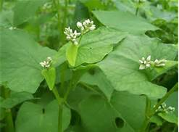
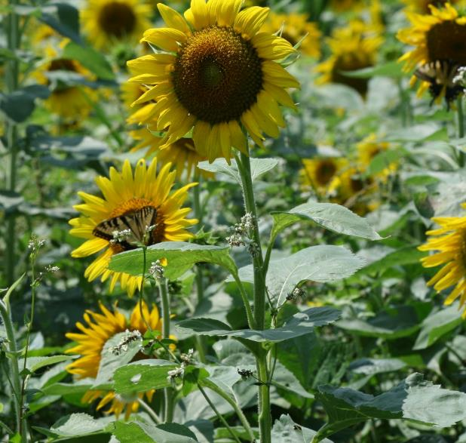

Warm Season Broadleaves
Buckwheat
Safflower
Sunflower
Buckwheat
Notes:
Discuss planting windows niches and potential advantages or management precautions.
Bulletin on buckwheat planning restrictions (2 yr from a wheat crop) see bulletin 190-16-8 ECS
Buckwheat: (top right) Buckwheat can flower in 4 to 6 weeks. It reaches 2¹⁄₂ feet in height. It has a branching tap root. Reported to help with surface compaction. It can be grown to maturity between spring and fall vegetable crops, suppressing weed growth and recycling nutrients during that period. Buckwheat flowers are very attractive to beneficial insects and of course honey bees. Buckwheat is an effective phosphorous scavenger due to production and release of mild acids. It is succulent, easy to incorporate, and decomposes rapidly(low C:N ratio). Buckwheat can be planted anytime in the spring, summer or fall, but is frost-sensitive.
Sunflower: (bottom left) Some seed sources inexpensive. Generally, oil seed varieties are utilized over confectionary types. Very deep taproot/compaction, N scavenger & good for attracting pollinators, Diversity. Good in mixes with Sudangrass and Sunn hemp and viney cover crops. Some varieties can flower even when planted in Mid summer. Sunflower is renowned for its extensive and prolific root system and its ability to soak up residual nutrients out of reach for other commonly used covers or crops. This species can also take advantage of short growing seasons in case of damaging hail or poor emergence to cash crops. If planning to harvest for oil or seed or simply to attract birds, sunflowers have very similar planting and harvesting methods to that of corn. Because insects are attracted to the bright colors of sunflower heads, pollinators and beneficial's such as bees, damsel bugs, lacewings, hoverflies, minute pirate bugs, and non-stinging parasitoid wasps are often found in fields of sunflower and in following crops. Sunflowers also work very well in cover crop cocktails/mixtures. With rapid early season establishment, additional covers under the canopy that normally don’t grow under cool conditions can begin to take advantage of warmer and favorable weather when sunflowers are growing slower. With upright growth and anchored plants in the soil, surrounding vining/climbing cover crop plants can support their own growth by working their way up to reach sunlight thereby providing the structure they need to grow. Because sunflowers can add significant biomass production in just a short growing season, they can also serve as additional forage or silage for livestock feed. (source greencoverseed.com)
Safflower: (bottom right) Safflower is a drought tolerant, annual, warm season broadleaf that can be seeded in cool soils. Safflower is exceptional at breaking hard pans, encouraging water and air movement into the soil profile, as well as scavenging nutrients from depths unavailable to most agronomic crops. It is capable of doing this due to its impressive taproot which has been observed to grow 8-10 feet in ideal conditions. Safflower provides excellent forage for grazing but most varieties become prickly with maturity, rendering the plants unpalatable for livestock. Baldy safflower is one of the world’s first spineless safflower varieties and has been developed specifically for grazing and cover crops. Baldy verierty can be handled with bare hands even at maturity and is palatable for livestock grazing. (Source greencoverseed.com)

Slide 31
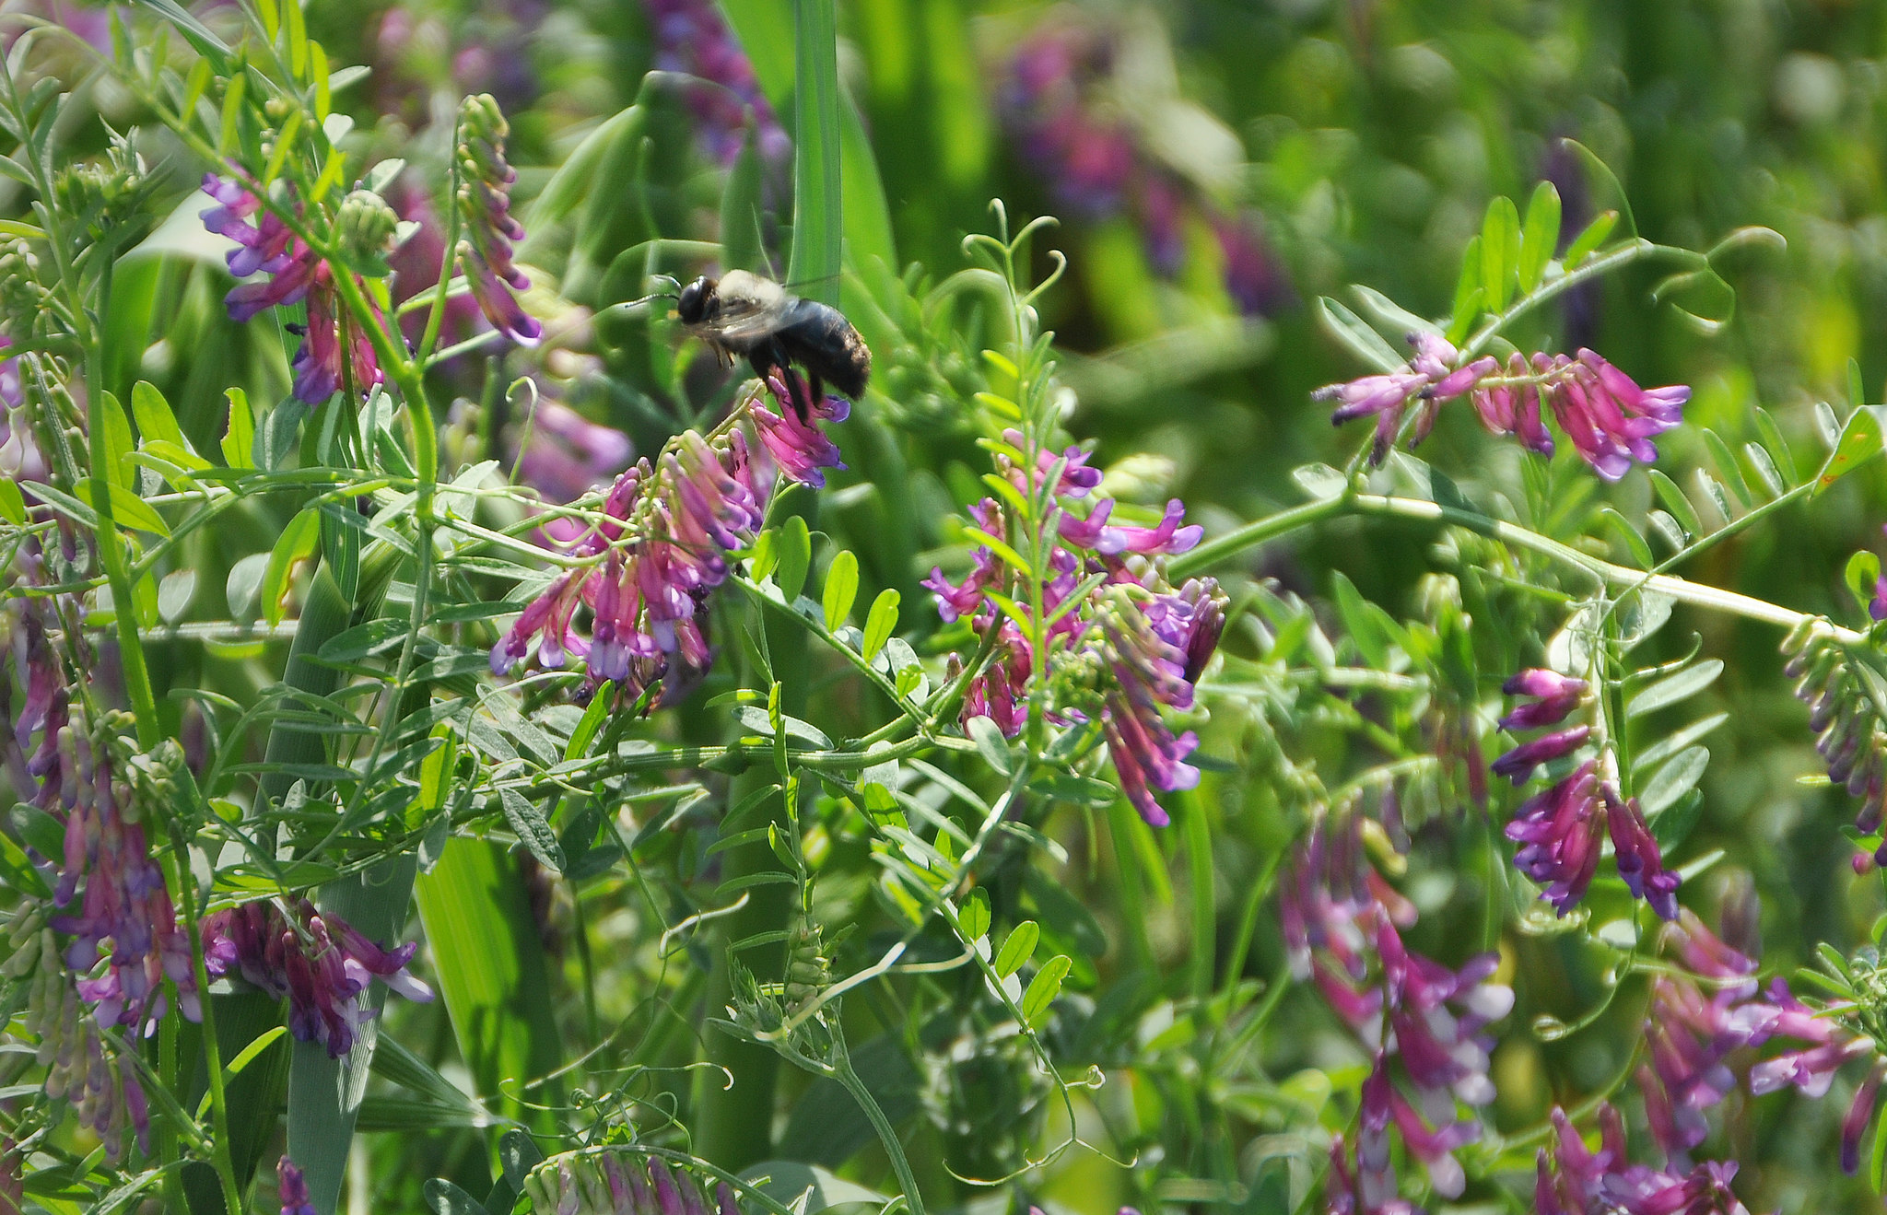
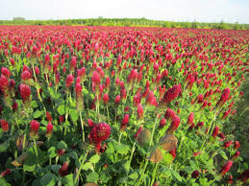
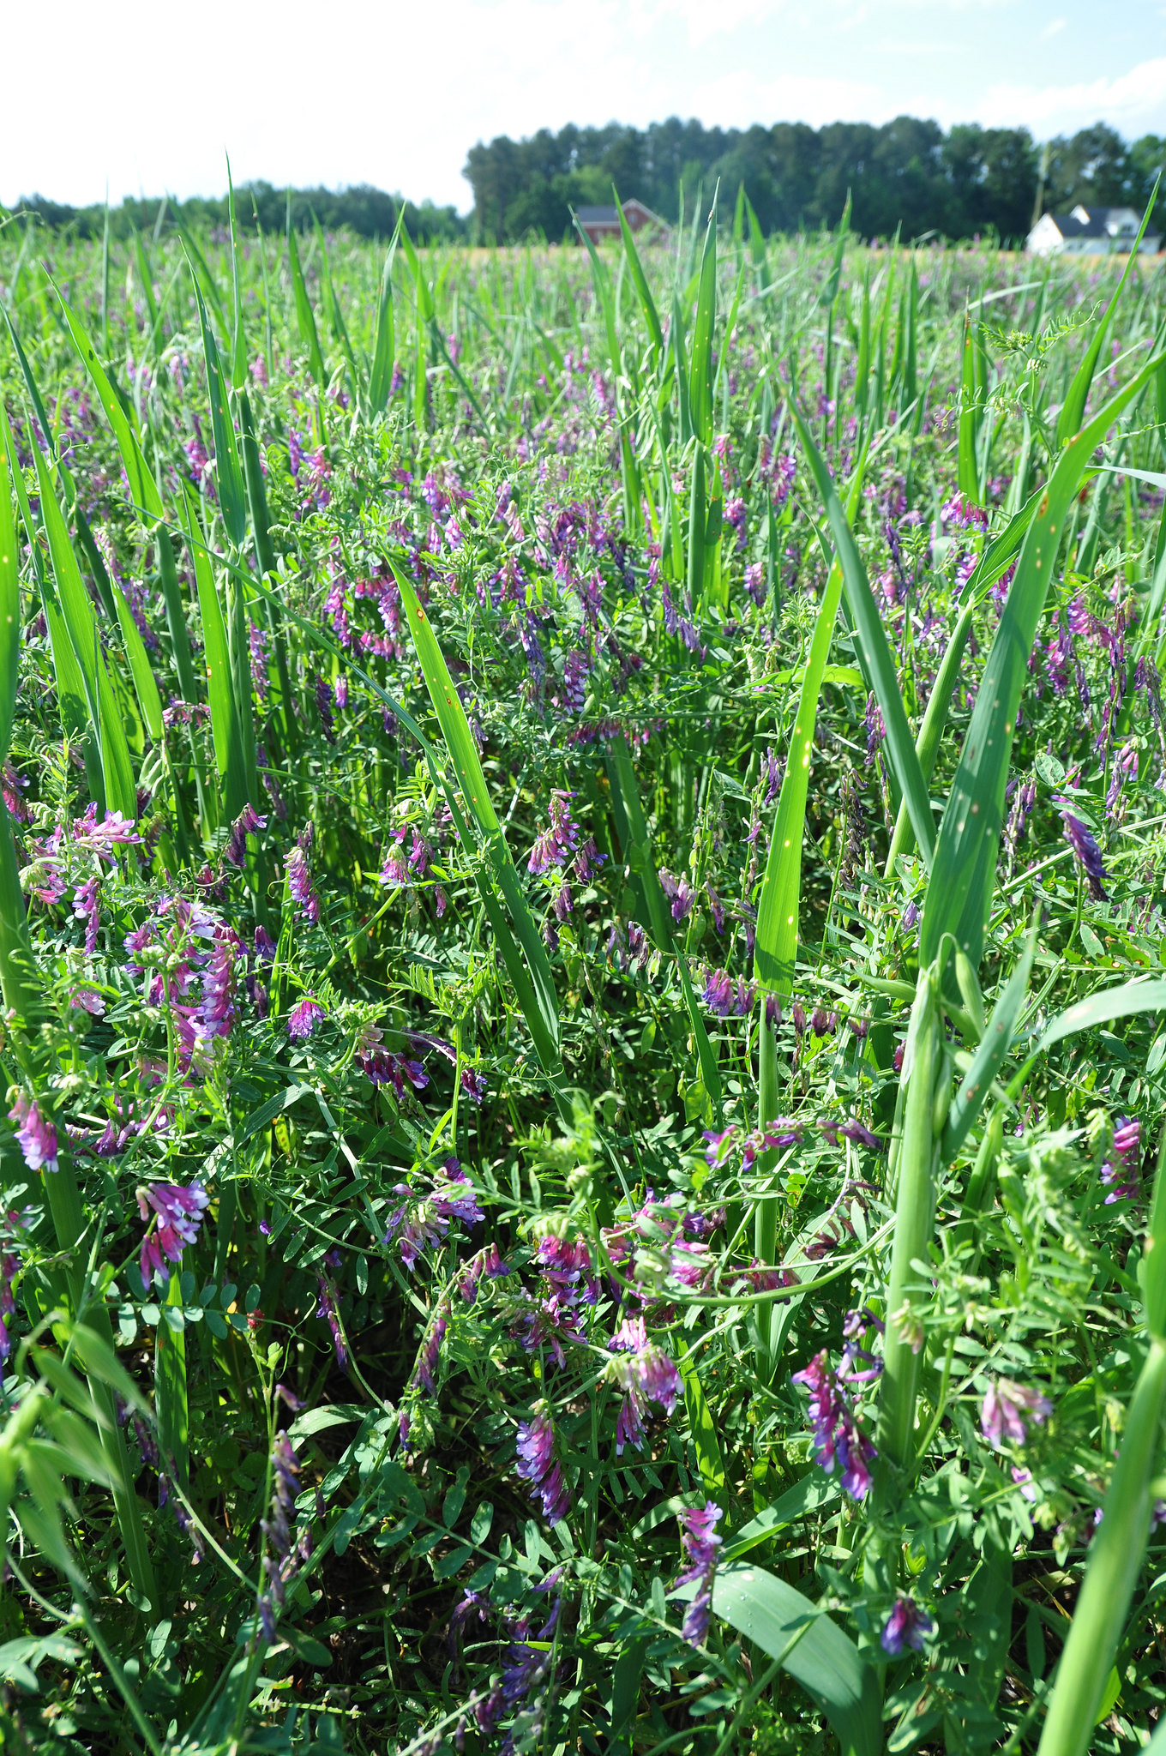
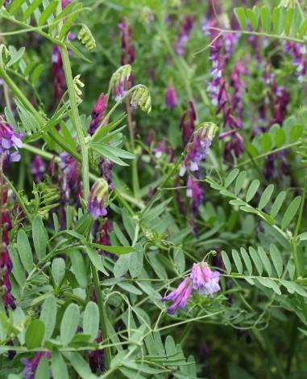
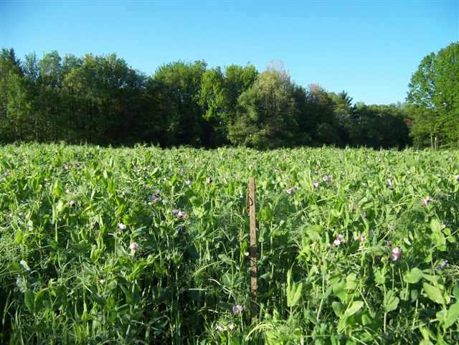
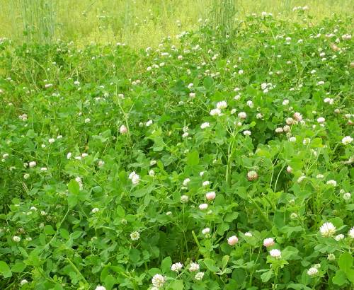
Cool Season Legumes
Vetch
  Hairy, Purple, Common, Woolypod
Crimson Clover
Perennial Clovers
  Red, White, Alsike
Winter Pea
  Austrian, Canadian
Notes:
Generally cool season legumes have been reported to be capable of fixing 100-300 pounds of nitrogen, dependent on seeding rate, management and growing season.
Generally small seeded legumes may contain a considerable percentage of hard seed.
Through a symbiotic association with the legume, Rhizobium bacteria convert atmospheric nitrogen into a form that the legume can use for its own growth.
Legumes produce the most nitrogen when at 50% bloom
Hairy Vetch:(bottom left) Ability to fix large quantities of nitrogen; produces high biomass; provides a weed suppressing mulch; winter hardy in most areas, will climb on to taller species, can cause issues with grazing if a major part of the mix. i.e. death
Winter pea:(bottom right) needs to be drilled or planted for good seed to soil contact due to larger seed size. Less hardy than Hairy vetch, expensive due to larger seed size when compared vetch or crimson clover (seeds per pound)
Crimson Clover: (top right) Early flowering, good N producer, Upright growth habit compared to other clovers;, good in mixes, inexpensive
Perennial Clovers: (bottom center)

Slide 32
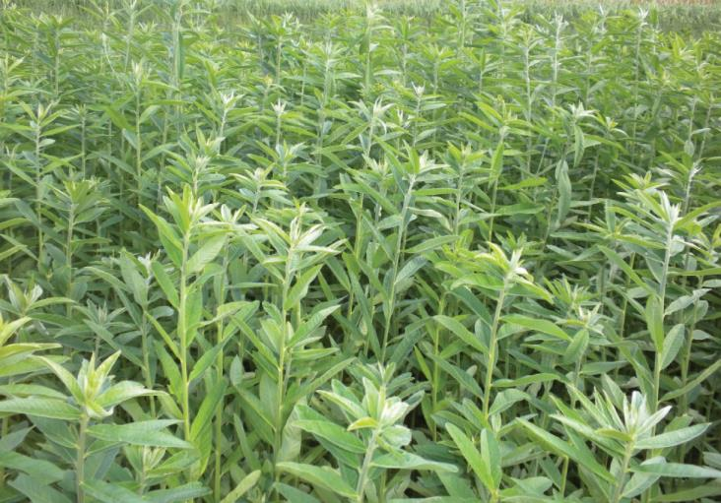
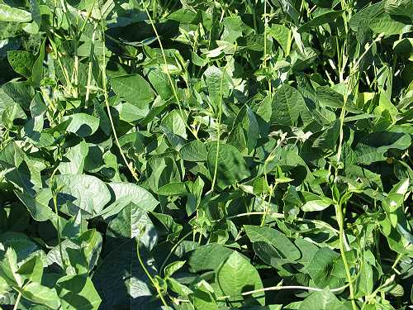
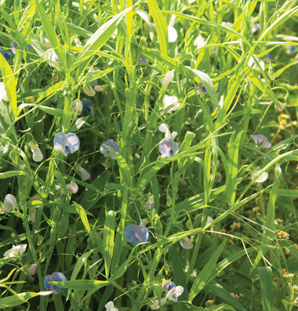
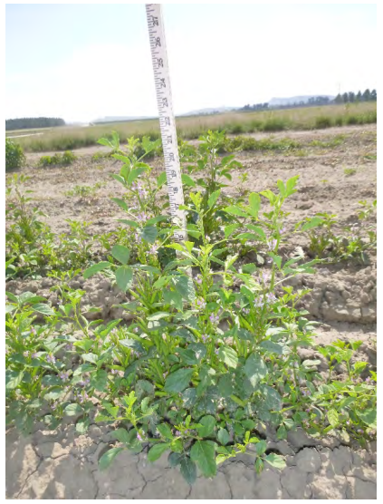
Warm Season Legumes
Cowpea
Soybean
Sunn hemp
Chickpea
Mungbean
Chickling vetch
Guar
Notes:
Discuss planting windows niches and potential advantages or management precautions.
Sunn hemp:(top left) upright, tall, grows well with tall warm season annual grasses. Extensive taproot, can fix large amounts of nitrogen in 60-90 days, Sunnhemp stalks become fibrous with age, but the plants will remain succulent for about 8 weeks after seeding.; It can tolerate poor, sandy, droughty soils. https://content.ces.ncsu.edu/summer-cover-crops.
Cowpeas: (top right) Vigorous cowpea varieties compete well against weeds, taproot that can obtain moisture from deep in the soil profile, it does well in droughty conditions, Maximum biomass is achieved in 60 to 90 days. Residues are succulent and decompose readily. Plants normally grow up to 2 feet tall, but some cultivars can climb when planted in mixtures with other species. Good mixture options are sorghum-sudangrass. Cowpea yields average 3000 to 4000 lb/acre of dry biomass containing 3 to 4% nitrogen.
https://content.ces.ncsu.edu/summer-cover-crops
Soybean: economical but preferred by wildlife, When grown as a green-manure crop, late maturing varieties usually give the highest biomass yield and fix the most nitrogen. Shallower rooted compared to cowpea.
Blooming period is also influenced by whether soybean varieties are determinate or indeterminate.
Soybean will grow on nearly all types of soils.
Chickling Vetch (bottom left)
Guar (bottom right) photo credit NRCS Plant Materials Center

Slide 33
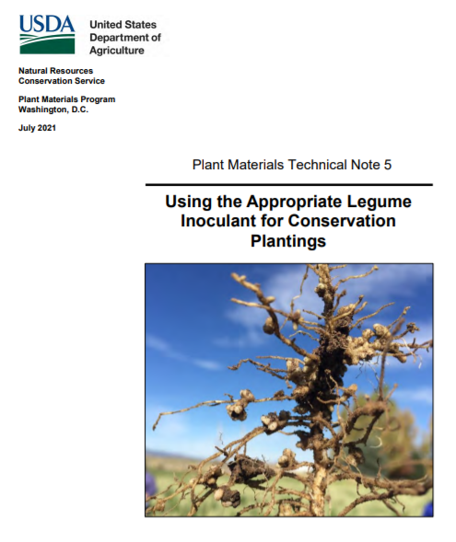
Need for Legume Inoculation
Inoculants help guarantee the successful formation of nitrogen-fixing nodules in legumes
Inoculants are species specific
Inoculants are alive and have a maximum storage life
Keep inoculant refrigerated out of direct sunlight and
Use prior to expiration date.
Notes:
USDA NRCS Plant Material Tech Note 5: Using the appropriate legume inoculant for conservation plantings. Great concise publication that is full of information including tables that help match the species specific rhizobia with common legumes. READ THIS BEFOREHAND
When root hairs find a compatible bacterial match they encircle the bacteria to create a nodule
The pinkish interior of the nodule are visible sign that nitrogen fixation is at work.
The bacteria contribute an enzyme that helps convert the N2 gas from the atmosphere to ammonia NH3
High nitrogen concentration in the soil from fertilizer or manure inhibits nodulation
Plant can contribute up to 20-60% of its carbohydrate production to the bacteria
N fixation peaks at flowering
These bacteria remain viable in the soil for 3 to 5 years

Slide 34
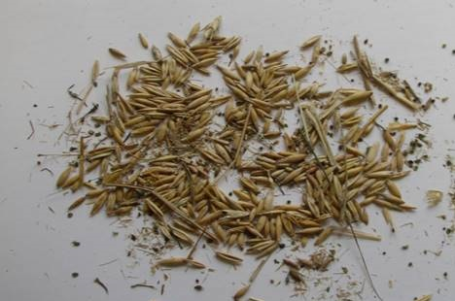
Bin Run Seed
Notes:
Bin run seed contains unwanted weed seeds, chaff and sometimes moldy seed. Several considerations should be kept in mind when planning with a producer who wishes to use. At a minimum seed should be cleaned to remove debris, weed seed, chaff and damaged seed. It should also tested for germination through sponsored state lab or through in office testing like ragdoll germination procedure. Also, refer to each states Cover Crop standard for specifics on availability for use in specific programs.

Slide 35
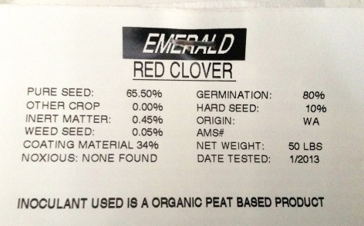
Certified or VNS
What is PLS?
PLS = purity x germ
65.5 x 90 = 58.95%
10#/ac seeding rate requires?
10#/ac / 58.95% = 16.9 #
PLS per bag
50# x 58.95% = 29.5 #
Notes:
Seed tag information PLS purity of seed coating 34% inert, Hard seed information 10% germination.
Certified vs VNS
VNS is cheaper may not know the adaptability important for some species.
Certified expensive important for some qualitites usually better quality seed due to higher requirements. Can’t get new varities of cover crops if not willing to buy certified seed.
To figure PLS rate, multiply the percent purity by the percent germination. Divide the seeding rate by the percent PLS to find the bulk seed needed per acre. For example: 65.5% purity X 90% germination = 58.95% PLS. Desired seeding rate of 10 lbs/ac / 58.95% PLS = 17 lbs/acre.
This 50 # bag would contain 50 lbs X 58.95% = 29 # PLS contained in the bag.

Slide 36
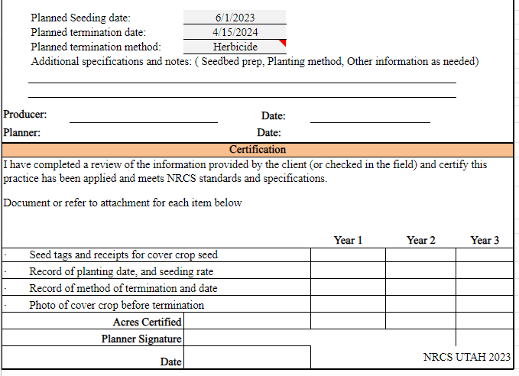
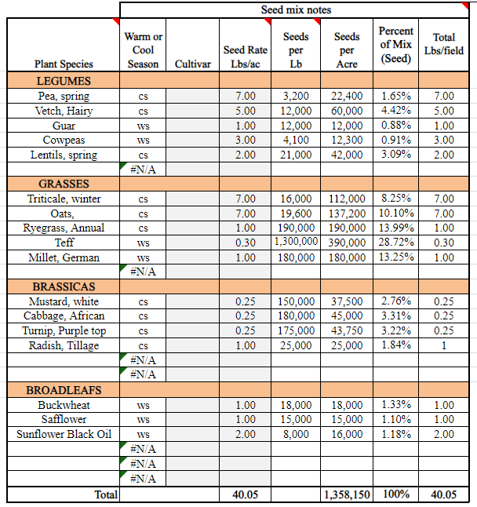
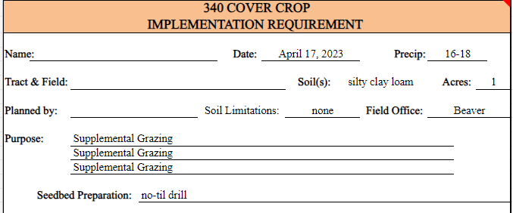
Completing 340 IR Sheet
Notes:
Insert your respective state 340 IR sheet for discussion. you may want to go over how to fill it out.

Slide 37
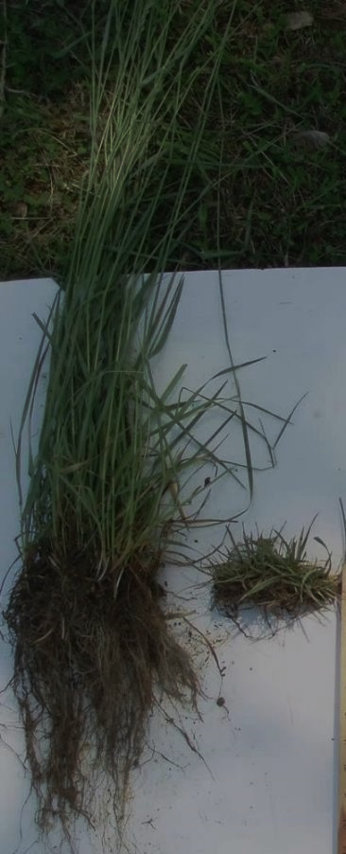
Knowledge Check
What are the four functional groups of cover crops?
Answer:
Warm Season Grasses
Cool Season Grasses
Warm Season Broadleaf
Cool Season Broadleaf
Notes:
For live presentations, show this slide and hide the previous one.

Slide 38
PMC Variety Trials
National Cool Season Cover Crop Adaptation Trials
  Regional Technical Notes
  PMC Study Reports
Spring planted cool season cover crops in the Northern Great Plains
Other Cool Season Cover Crop Trials
Warm Season Cover Crop Adaptation Trials
Notes:
These are active hyper links click to open and peruse the sites as needed. If not you can share the web page it is https://www.nrcs.usda.gov/plant-materials/cover-crop-performance-and-adaptation-trials
National Cool Season Cover Crop Adaptation Trials
Plant Materials Centers (PMCs) at over 20 locations conducted a 2-year evaluation of nearly 60 commercially available varieties of balansa clover, black oats, black seeded oats, cereal rye, hairy vetch, crimson clover, oilseed and daikon radishes, red clover, and winter/field peas to assess their adaptation and performance as cover crops across the United States.
They also have technotes available for each Region on the web address: https://www.nrcs.usda.gov/plant-materials/cover-crop-performance-and-adaptation-trials Each regional technote will be int eh resources page in the lesson plan folder.
The technical notes summarize data collected by PMCs in each region of the U.S. for the 2016-2017 and 2017-2018 winter cover crop seasons and in selected locations for 2017 and 2018 spring-seeded cover crop seasons. Information is provided in a table format that allows conservation planners and producers to determine the performance and potential adaptation of a cover crop for each area at a glance. These reports include information for all cover crops except for balansa clover which had high variability of establishment among locations.
There are also national trials for each state: National Trials - Plant Materials Center Study Reports
Each Plant Materials Center report includes detailed information on the results of all cover crops in this study, including balansa clover. Some reports may include three years of data as well as biomass measurements for the different varieties.

Slide 39
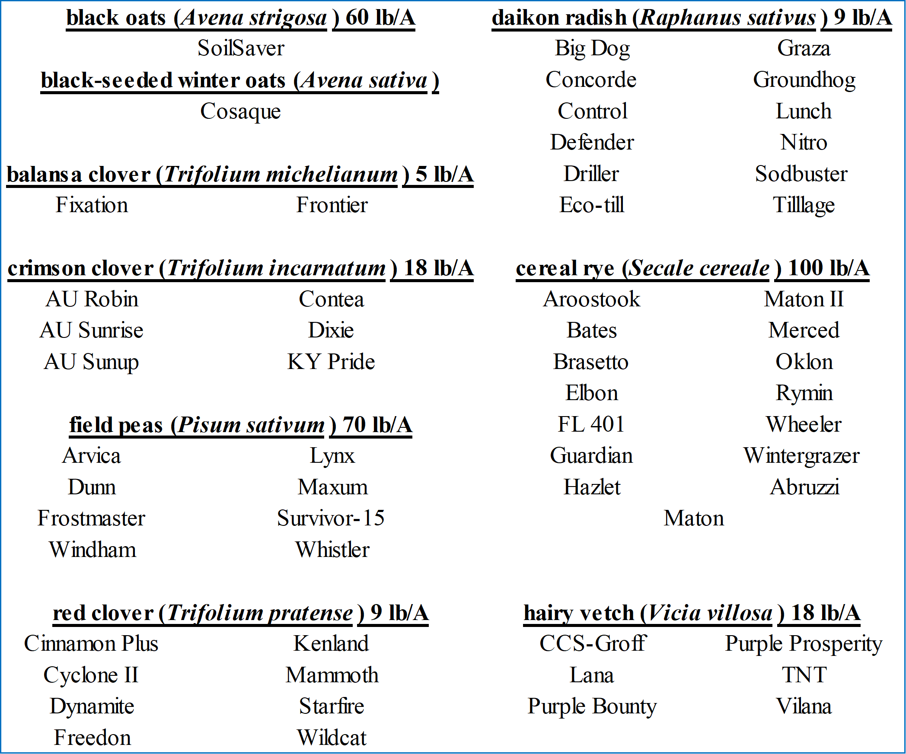
Cultivars Vary
Notes:
Can be critical depending on the species and your location
Especially if you are seeding annual ryegrass, ensure that you know the variety. Some species are extremely difficult to terminate.
If you have a variety that is identified, you are making a more informed decision and you have a better understanding of how that plant will behave which leads to better management and helps you meet your objectives.

Slide 40
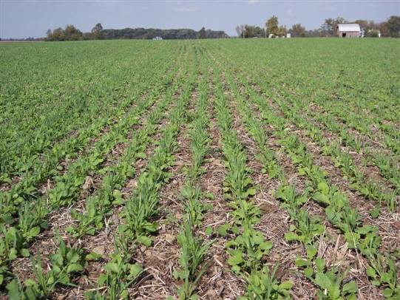
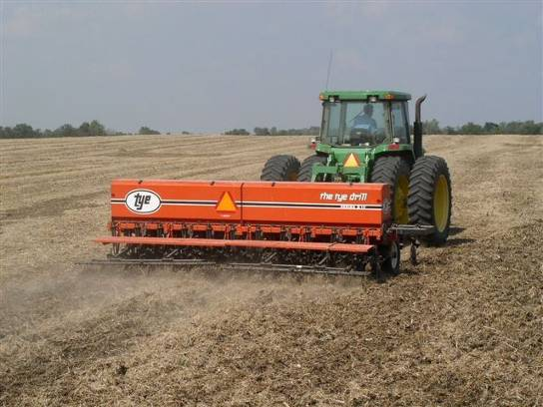
How will you seed it?
Drill
Most time consuming
May allow reduced planting rate
Provides row plant spacing
Consistent results
Good soil to seed contact
Notes:
Check out cost of drilling excluding seed.
Cost estimates for operation provided by Iowa State 2018 Custom Rate Survey
https://www.extension.iastate.edu/agdm/crops/pdf/a3-10.pdf

Slide 41
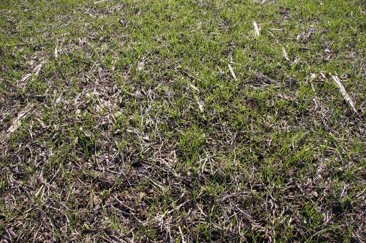


How will you seed it?
Air Seeder on a Harrow or Vertical tillage
Wide swath at 10 mph
Fast
Provides a random plant spacing
Soil disturbance
Notes:
Air seeders mounted on vertical tillage tools or rotary harrows may have many advantages over broadcasting alone, particularly if the farmer already owns the equipment. An air seeder could be mounted on the vertical tillage tool ( why did you have sprayer that would be more for into standing crop?)
Seed can also be blended with fertilizer or pell lime and broadcast ahead of the incorporation tool for best results. Sometimes spread after, but not recommended ( best if can be timed just ahead of a rain)
Cost estimates for operation provided by Iowa State 2018 Custom Rate Survey excluding seed
https://www.extension.iastate.edu/agdm/crops/pdf/a3-10.pdf

Slide 42


How will you seed it?
Fly it on
Most flexible timing
Fast
Provides a random
plant spacing
No seed to soil contact/moisture dependent
Higher seeding rates may become impractical
Notes:
Select aerial applicators who have experience in Cover Crops
Cost vary widely depending on seed type, seeding rate, size of fields etc. **Add a local cost list for flying on seed

Slide 43




How will you seed it?
Fly it on…When?...What?
Target the optimum window
Balance sunlight and moisture
Growing Degree Days
Some species are more adapted, seed size
Lack of soil to seed contact/Moisture dependent
Notes:
What species are more adapted, like annual ryegrass, cereal rye, triticale
Target the optimum window, for the cover crop establishment after black layer in corn and when at least 60% of the field of soybeans has turned yellow and ready to drop.
Sometimes timing is critical and you can’t find the people to do this so it can be prohibitive.
This may be the only option for low equipment people or operations large in scale.

Slide 44


How will you seed it?
Highboy for establishing into standing corn
Notes:
When there’s a will… farmers will find a way! Farmers and ag retailers are adding dry seed box modifications to their high clearance sprayers. Most report that they can convert from wet application to dry in about a half day. Examples-Dave Brandt, Carrol, OH and Mike Shuter’s seeder near Frankton, IN

Slide 45



How will you seed it?
Air Seeder on Combine Head
Ray McCormick, Vincennes, IN
Concurrent operation
Cheap / Fast
Provides a random plant spacing
Seed placed beneath the residue
Notes:
Some producers are mounting air seeders on combine heads. Ray McCormick’s Gandy seeder.

Slide 46


How will you seed it?
Precision planting in narrow rows (15” rows)
Use existing bean planter
Less seed per acre
Provides precision row/ plant spacing
Consistent results
Good soil to seed contact
Notes:
Pictured: (Brassica and Small Grain) Precision planting is possible with planters and this is a way to reduce seed cost as well as strategically utilize species that winter kill with species that provide n fixation (biological strip-till). RTK allows the precise planting adjacent to the winter killed row. Possible Challenges, winter kill results in bare ground in absence of brassicas

Slide 47





Inter-seeding Options
Interseeding into V6 Corn
Crimson clover about 8 weeks
after interseeding
ARG, legume mix
Annual ryegrass Oct 30th Central NY
Notes:
Interseeding has a potential allowing for legumes to be grown in Northern Climates following silage corn when there is adequate soil moisture and corn yields which do not shade out the cover crop. Residual herbicide persistence and weeds are a challenge.
Innerseeder photo from Penn State University.
Soybeans can be interseeded into wheat.

Slide 48



Planting Green
Advantages:
increased biomass for weed control
better planter performance in standing cover vs a thick mat
more biomass reduces evaporation and erosion
Plan accordingly to reduce potential challenges
increased pest pressure (green bridge?)
more risk of wrapping on planter drives and wheels; hair pinning
pollen shed plugging breathers or air flow devices
over utilization of moisture.
Notes:
Advantages: Maximizes photosynthesis opportunities enabling the improving the carbon cycle. Cover crops can be managed to remove excess moisture in wet seasons.
Better planting performance in standing residue vs. residue already on the ground due to issues with coulter or disc opener problems cutting through the residue – hairpinning can occur (pushing residue down into the seed trough and interfering with seed placement the residue acts as a taco shell and the seed sits in there and is then at a disadvantage from desiccation or piping of soil moisture from the seed trench to the environment) make sure you plant deep enough to make an impact on the cutting edge of the disk openers rather than shallow which pushes the residue in instead of cutting it causing hairpinning.
Photo 1 is a diagram describing hairpinning the second photo is an actual yield monitor map showing where hair pinning caused 20% red. In yield. https://gooseneckimplement.wordpress.com/2017/07/18/hair-pinning-101/
Disadvantages: These are commonly seen WHEN producers attempt to plant in dying cover crop residue. During this time residue becomes very tough and rubbery creating less than optimal conditions for planting. Green fresh residue or brown crispy brittle residue are desired conditions to avoid some of the listed disadvantages dealing with equipment.
In the pictured example, the producer is planting green and will followed up with herbicide application to terminate cover crop
Planting green is not the same with every producer nor is every cropping season. Producers will find that flexibility is key to a successful SHMS.

Slide 49

Cover Crop Termination Methods
Herbicide burn down
Tillage
Frost termination
Crimper / Roller (mature enough to kink the stem)
Grazing– Not in Termination Guidelines
Shredding / mowing
Combination of methods
Notes:
Order of success of termination
This is a topic that usually raises a lot of questions. There are many ways to terminate cover crops and a lot will depend on the climate of the area and the objective of the producer. There are many variables when considering termination methods. Instructors should be able to discuss examples of where each method could and may be used. Be aware of crop insurance guidelines.
Frost termination: used in climates where temperature falls below ideally growing conditions for cover crop species and kills crop
Crimper/Roller: Can be used in independently or as combination. To be used independent, crimper/roller must snap, crimp, or break vegetation stems to stop flow of nutrients throughout the plant. Must be completed when target species reaches early maturity before viable seed.
Herbicide burn down: popular method on grain operations. Completed before or after planting operation by applying herbicide to kill vegetation.
Grazing: Use of animals to graze and trample cover crop vegetation to aid in termination. Time grazing period close to early maturity of vegetation. Implement take half leave have rule to support soil biology and soil health management principles. Residue cover aftermath needs to be monitored. Unless your using winterkilled varieties, this is very difficult to do.
Shredding/Mowing: Use of equipment to mow or shred cover crop material near maturity to aid in termination and sizing residue. Caution – Mowers have tendency to direct residue in rows behind or beside swath that could provide planting problems. Also be cautious that cover crop material is loose and will move and could be come tangled in equipment. Shredded and mowed residue may breakdown faster due to sizing of material through process.
Organic Methods: Flaming with handheld or pulled flamer that comes in contact with cover crop material that aids in termination. Plastic or tarps can also be used to cover a area to kill vegetation.
Combination of methods: Producers may use two or more methods to kill cover crop. Ex. Herbicide burn down to kill cover crop followed by roller crimper to place residue on the ground for maximum weed suppression and to provide easier planting operation.
NOTE: It is important to consider when producers new to cover crops should attempt to plant cash crops into cover crops. To answer that question does contain several variables that are crop dependent. However, cash crops should be planted into cover crop residues that are either actively growing with fresh green residue or completely dried/brittle residue to avoid problems with planter operations. If cover crop residues are in the process of dying or breaking down, residue becomes very tough and troublesome to accommodate planting operations. Problems with cover crop residues dragging up, clogging, wrapping and hairpinning will likely be observed.

Slide 50



COVER CROP -Termination
When and How?
Have a good GAME PLAN…
  What are your goals?
Be adaptive to the season
  Wet springs happen!
Notes:
(optional)
Along with planting come a need to have a well planned termination strategy. Timing can be critical so seek advice from experienced growers and or specialists. For some cover crops you will need your game face on!

Slide 51

Cover Crop Herbicide Restrictions
Forage and grain (food chain)
  Herbicide must be labeled for all crops
  Rotation/plant back restrictions
  Forage restrictions (grazing, haying)
Cover only (soil building or erosion)
  At your own risk (some labels lack info)
  Review labels/experience
  Climate & soils (biological activity)
Notes:
There are several considerations to look at when planning or planting cover crops. Herbicide residuals could terminate desired species in cover crop mixes.
Look at resources in the resource folder for Kevin Bradly Cover crop issues from herbicide carryover. https://extension.missouri.edu/media/wysiwyg/Extensiondata/Pro/WeedScience/Docs/CoverCropCarryover.pdf

Slide 52
Herbicide Restrictions from a Planning aspect
Planner Needs:
Determine producers crops in the system
Need to inventory producer herbicides
May need to look up labels, Look at plant back timing.
Decide if your species mix will be an issue
Producer Needs:
Follow label
Do a bioassay to assure no carryover
Check with the planner if they need to switch a species out of the mix
Notes:
Make note of this comment: Carryover potential from crop to cover crop and cover crop termination to crop
Challenging to predict potential carryover of herbicides to cover crops with exhaustive variables.
Careful planning can help increase confidence.
A bioassay is a technique for determining if herbicide (or other chemical) residues are present and bioavailable in soil or water at high enough concentrations to adversely affect plant growth. This is a simple, economical, and direct method to determine if it is safe to seed or plant into areas previously treated with herbicides or into soil with an unknown history of herbicide use.
See the link above and/or the pdf from NC State on how to conduct a bioassay in guidance documents folder see cover crop module subfolder

Slide 53

NRCS Termination Guidelines
Notes:
Cover Crops | RMA (usda.gov) Visit this RMA sponsored site for the latest information on crop insurance and cover crop use.

Slide 54

Covers and Pest Management
Reduce sunlight reaching soil surface
Alter micro-environment during weed seed germination
Release of chemicals from roots or decaying residue to inhibit weed seed germination (allelopathy)
Improve overall soil health to enhance crop vigor
Physical barrier to pathogens
Notes:
If weed management is a purpose for planning cover crops, the covers need to be established and terminated prior to problem weed germination.
Be sure to state that at the start of the system and you introduce cover crops that the soil is highly degraded and you may end up causing an alternative problem to the following crop. The cover crop may harbor a vector.

Slide 55

Residue Effect on Palmer Amaranth
Notes:
JS Petrosino, MS Thesis, Kansas State University

Slide 56
Cover Crop Planning Tools
Cover Crop 340 Practice Standard
Cover Crop Councils
Resources and Publications—Soil Health Division
Sustainable Agriculture Research & Education (SARE)
  Online Book and Topic Room on Cover Crops
Cover Crops for Sustainable Crop Rotation and Soil Health and the SARE cover crops topic room
No-Till Farmer: The Pluses And Minuses Of Today’s Most Popular Cover Crops
Various industry cover crop calculators
Notes:
Add notill farmer pulses and minuses. States can add additional local resources as needed

Slide 57
Soil Health Principles to Support High Functioning Soils
Maximize Living Roots
Minimize Disturbance
Maximize Soil Cover
Maximize
Biodiversity
Feed
Fuel Soil Biology
Improve Resilience
Improve SOM
Protect
Soil Aggregates
Organism Habitat
SOM
Notes:
Soil organisms are driving the benefits obtained through achieving and improving the condition of the four principles. Therefore, the principles can be viewed from the perspective of how they benefit the soil ecosystem.
Feed diverse, continuous inputs (C sources, energy). The “feeding” benefits to the soil community arise predominantly from roots and diversity.
Protect habitat (aggregates and organic matter). The “protecting” benefits to the soil community arise predominantly from disturbance and cover.
Maintain SOM & aggregates; Reduce erosion & runoff risk
Buffer temperature; Reduce evaporation
Feed: Break disease cycles; Stimulate microbial diversity; Increase SOM and nutrient cycling
Enhance plant growth; Increase predator & pollinator populations

Slide 58

This information is provided as a public service and constitutes no endorsement by the United States Department of Agriculture or the Natural Resources Conservation Service of any service, supply, or equipment listed.
While an effort has been made to provide a complete and accurate listing of services, supplies, and equipment, omissions or other errors may occur and, therefore, other available sources of information should be consulted
The USDA is an equal opportunity provider and employer.
Meeh, NRCS

